Slide 1
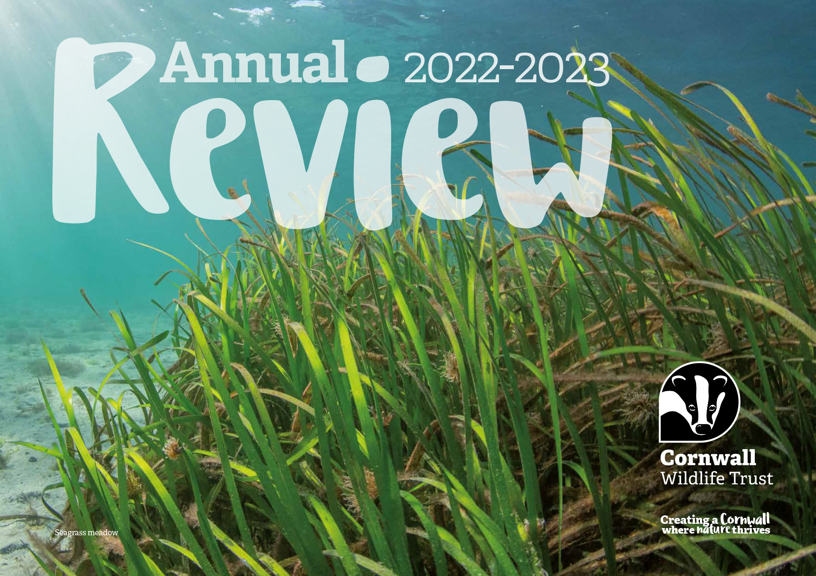

Slide 2
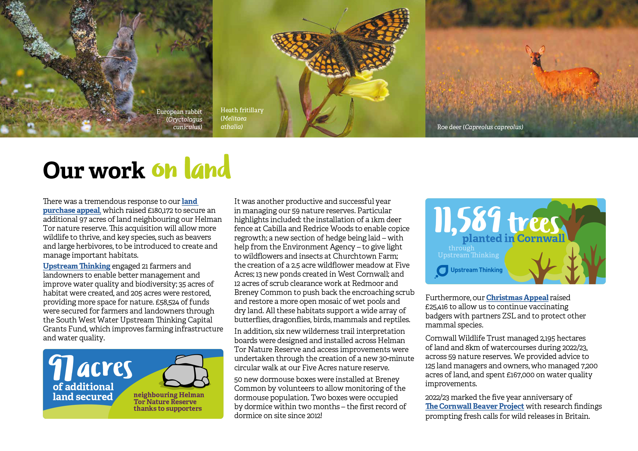

Slide 3
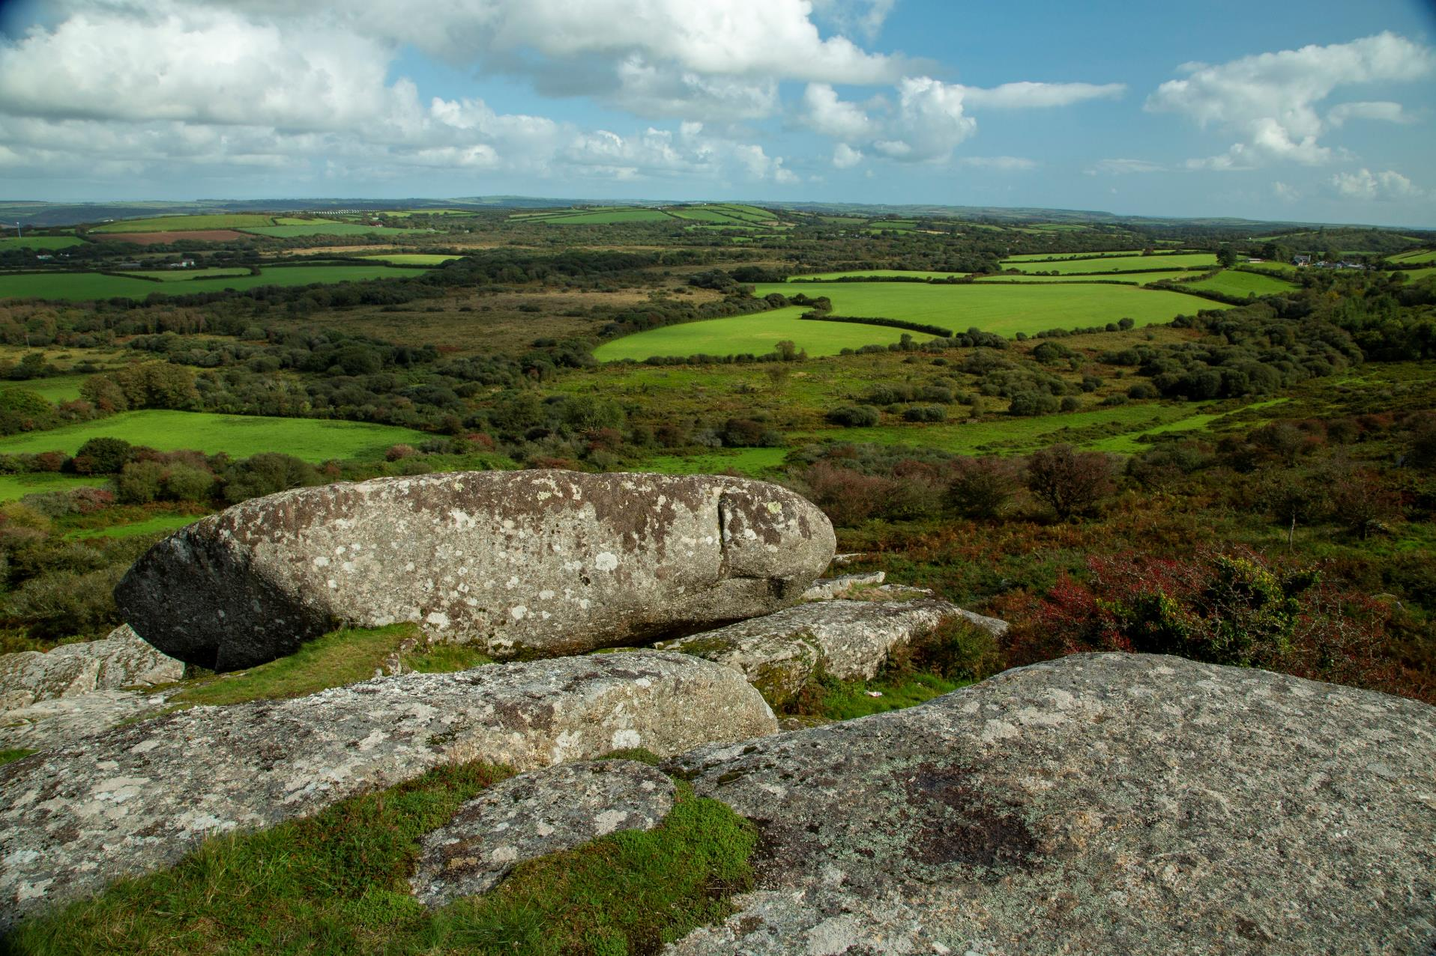
Notes:
Creney Farm viewed from the Tor

Slide 4
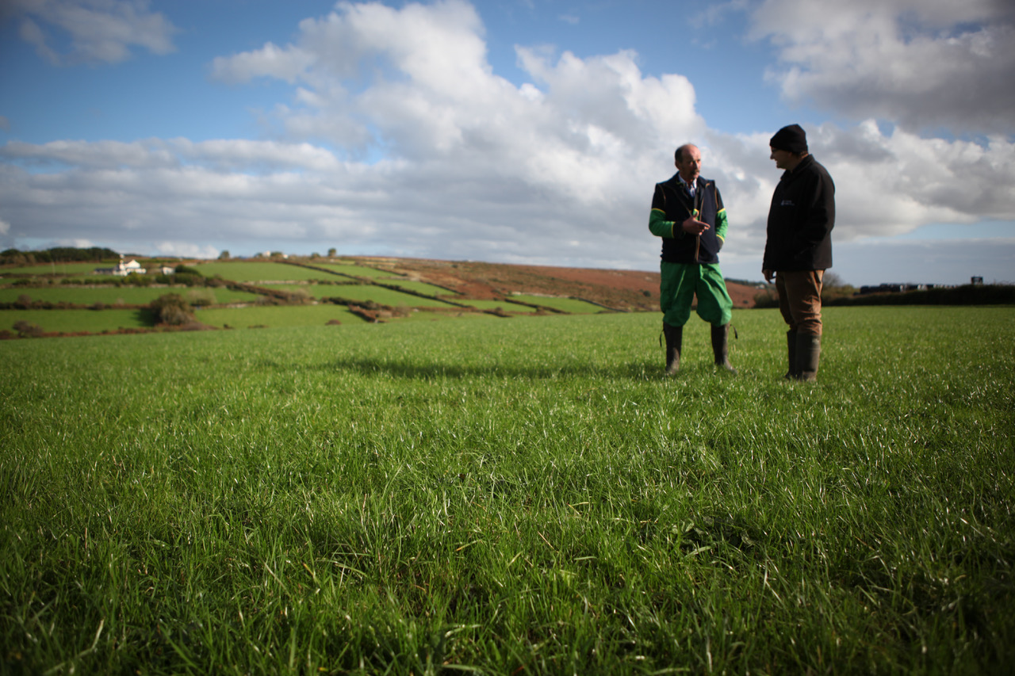

Slide 5
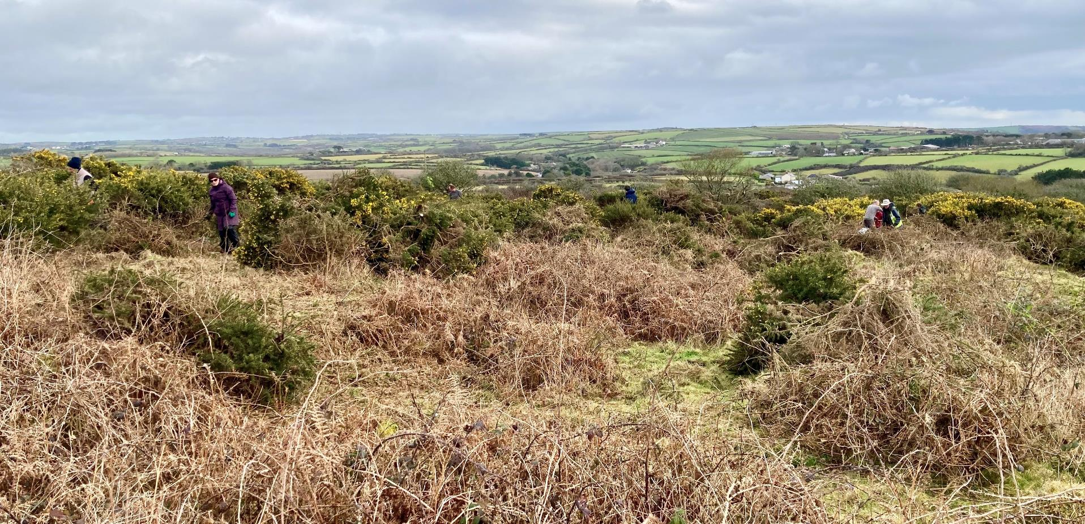

Slide 6
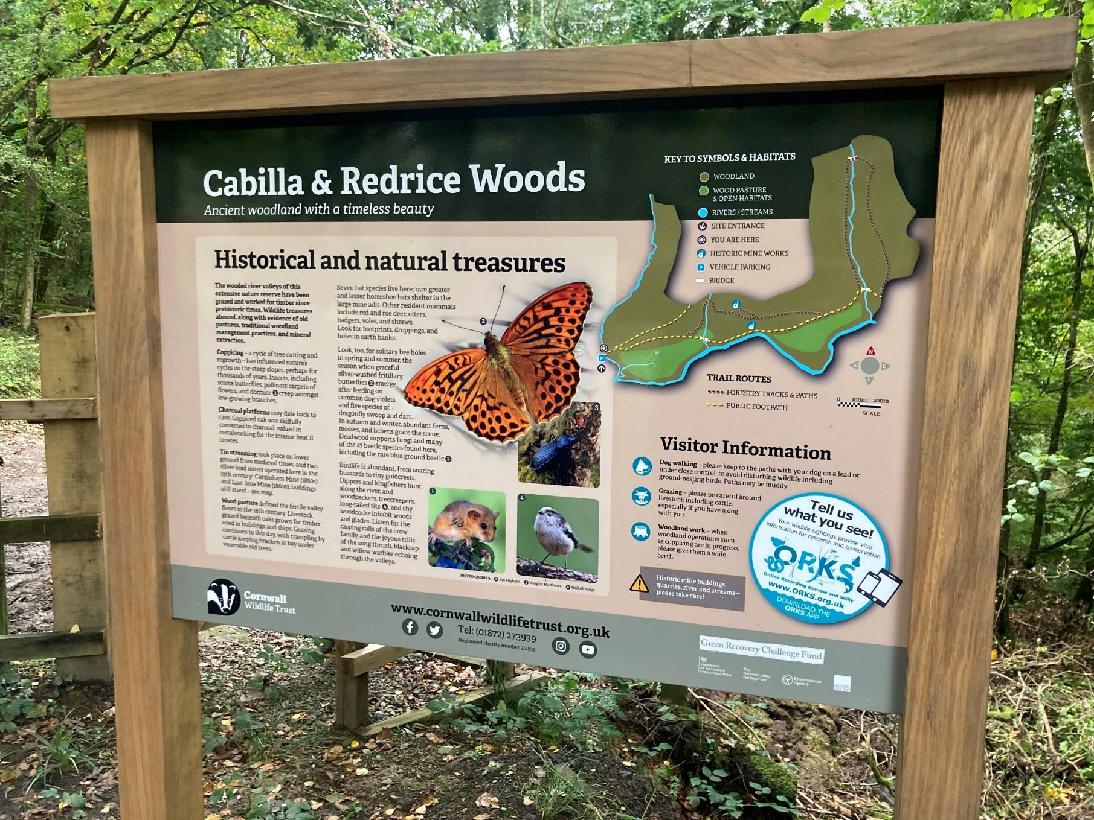

Slide 7
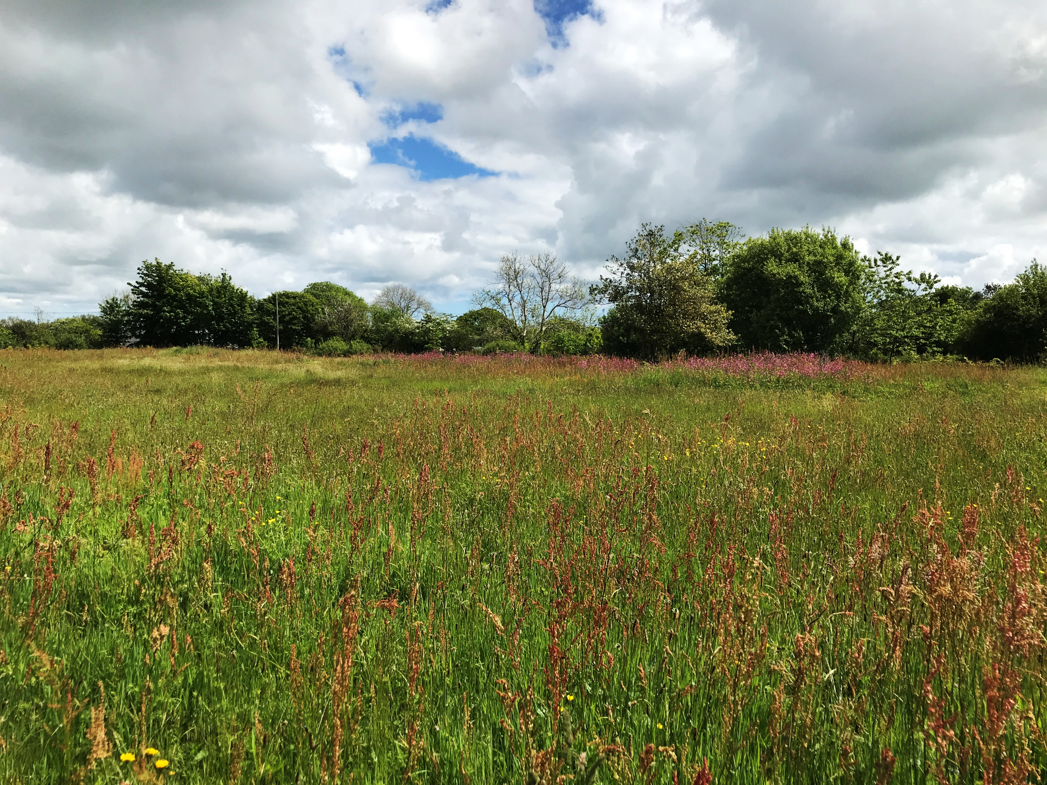
Notes:
Five Acres

Slide 8
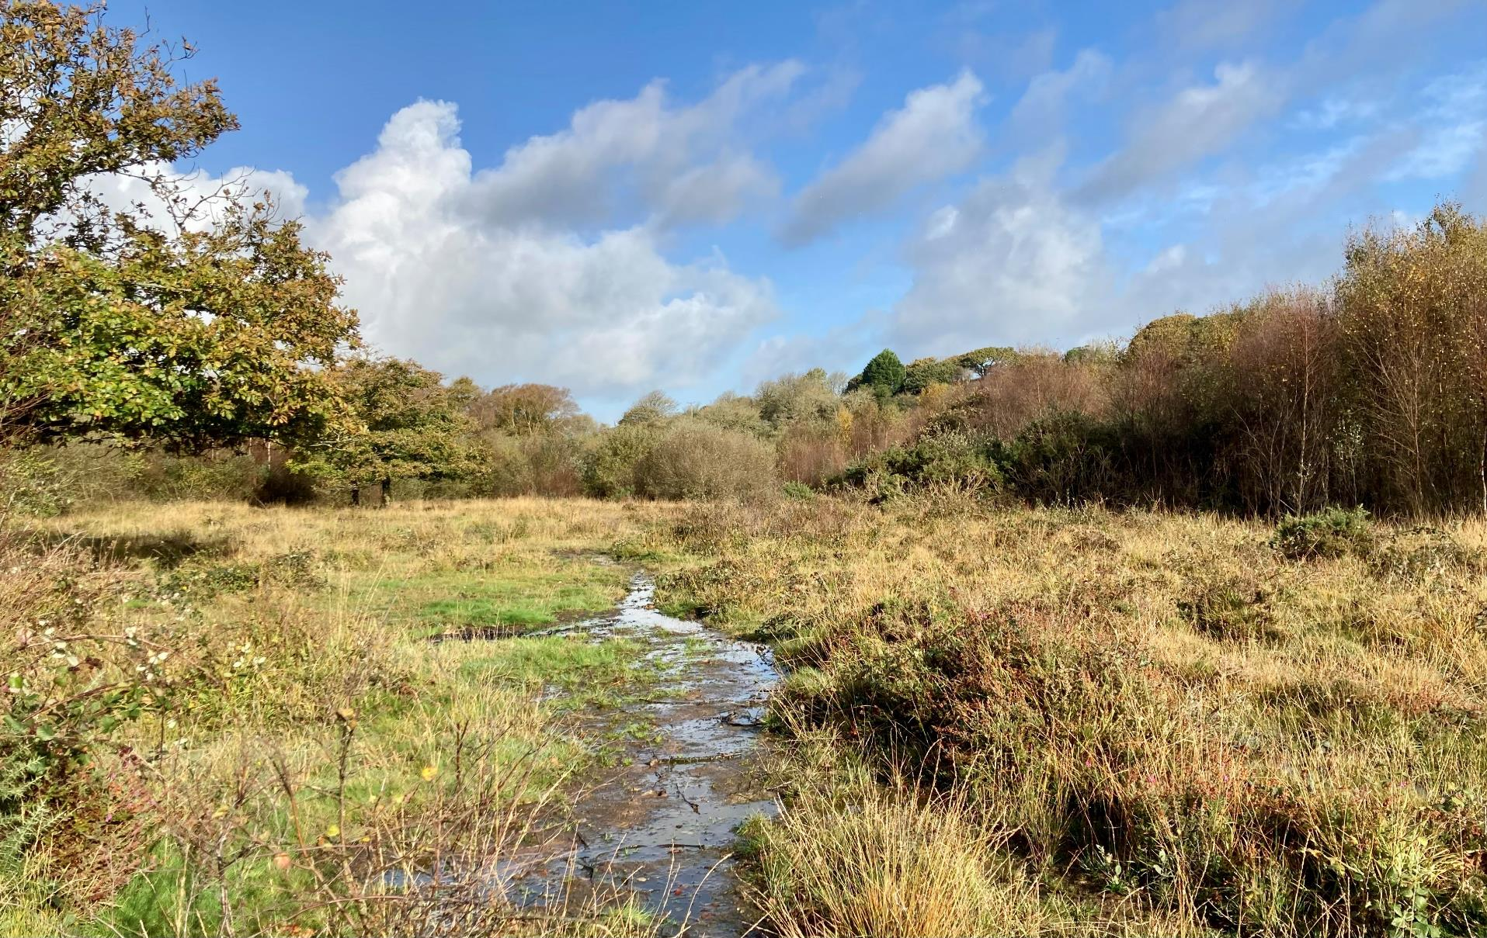

Slide 9
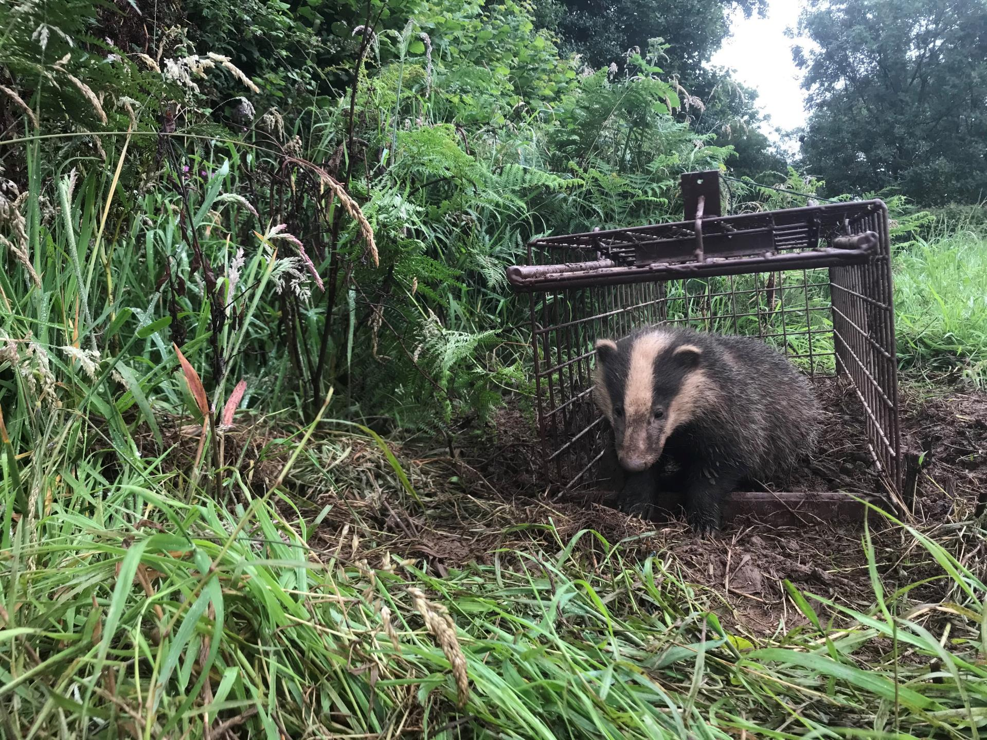
Notes:
Badger vaccination

Slide 10
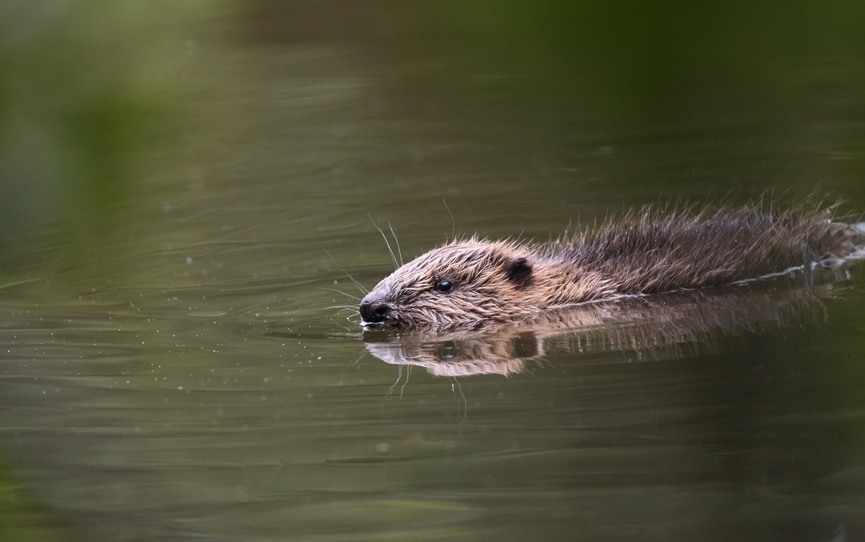
*
© Adrian Langdon

Slide 11
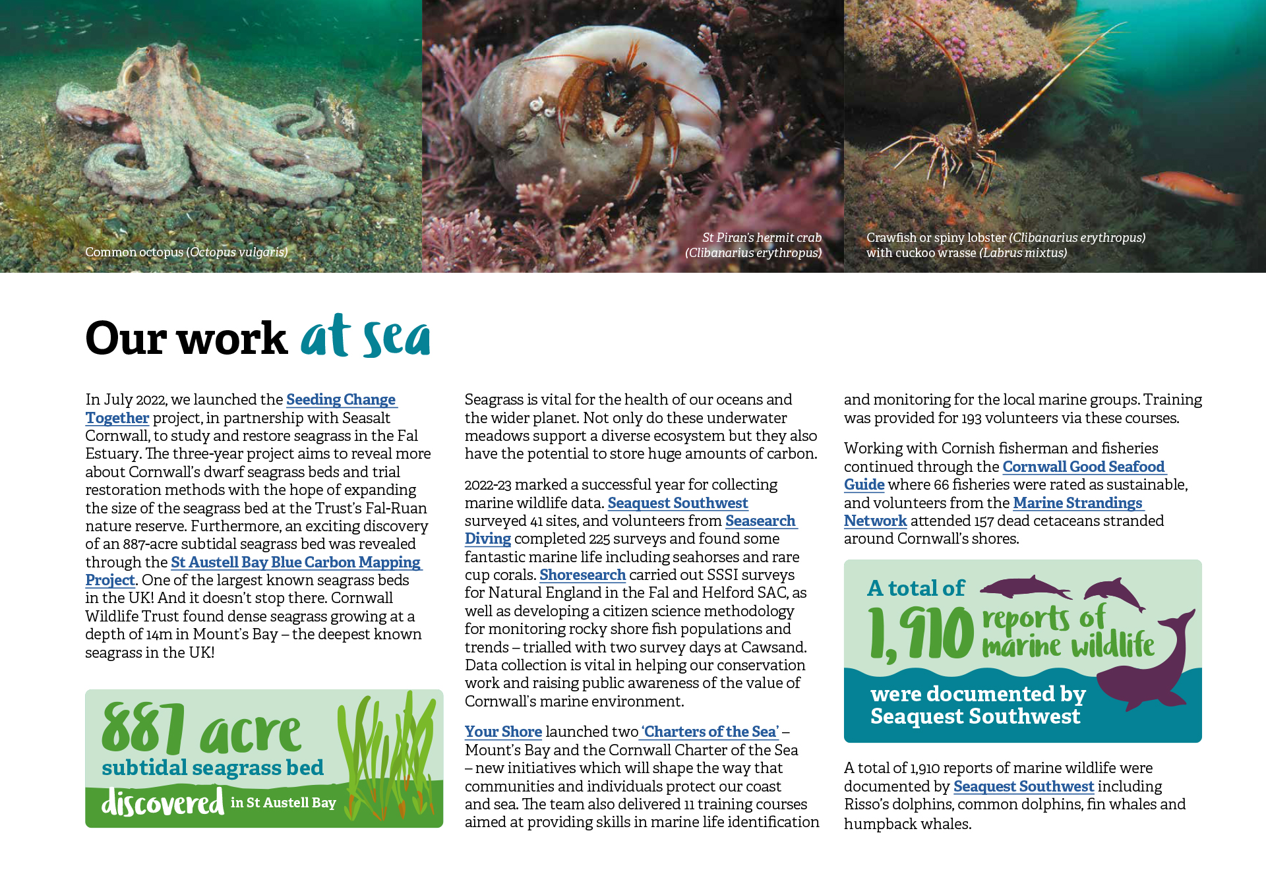

Slide 12
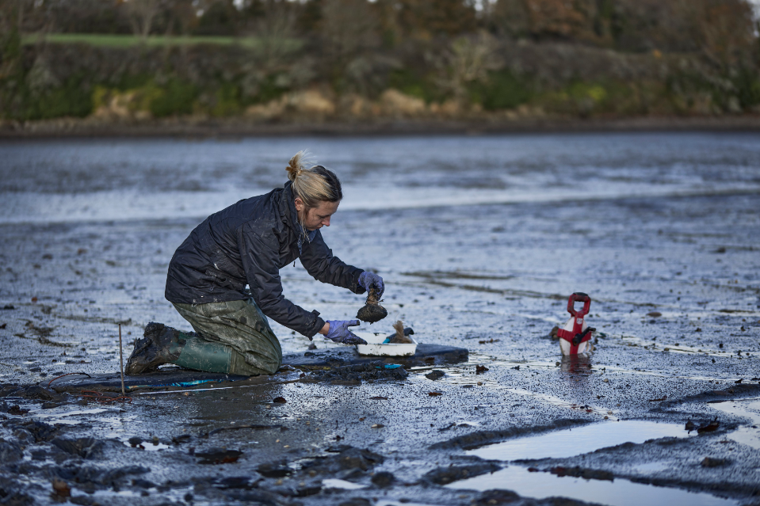
© Seasalt Cornwall
Notes:
Seagrass restoration

Slide 13
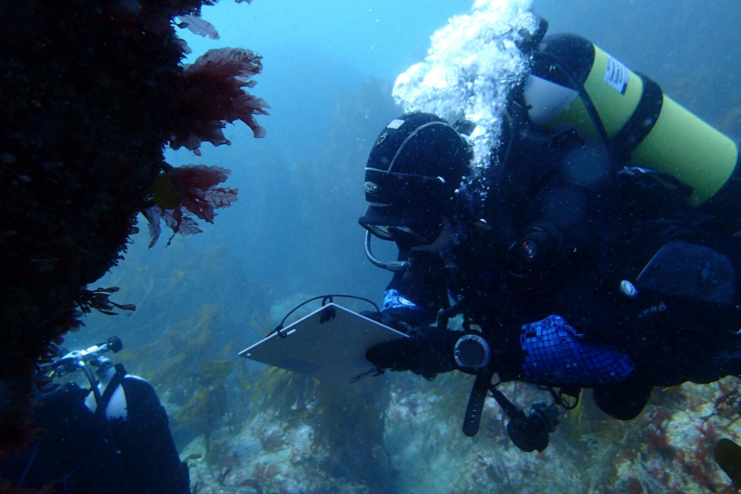
Notes:
Marine monitoring/Seasearch/Shoresearch

Slide 14
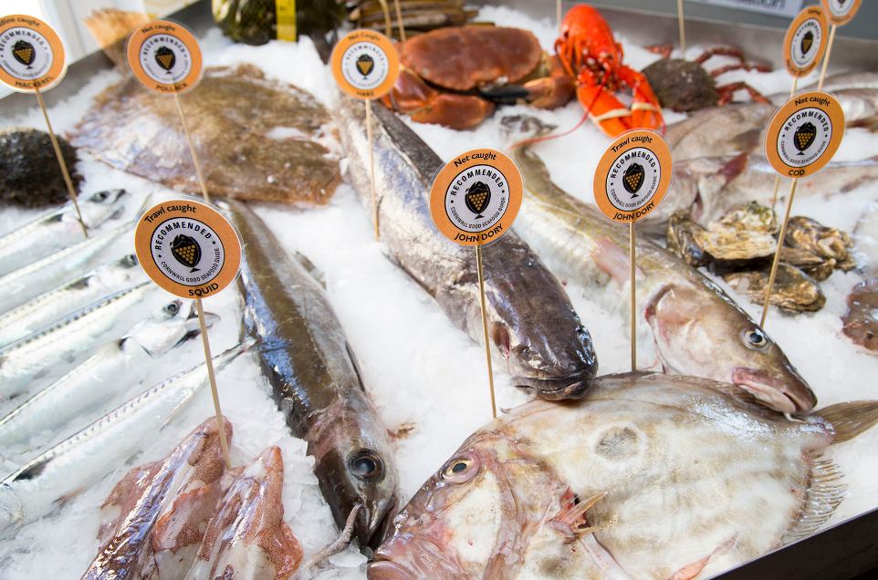
Notes:
Fishing/fisheries (ref Good Seafood Guide)

Slide 15
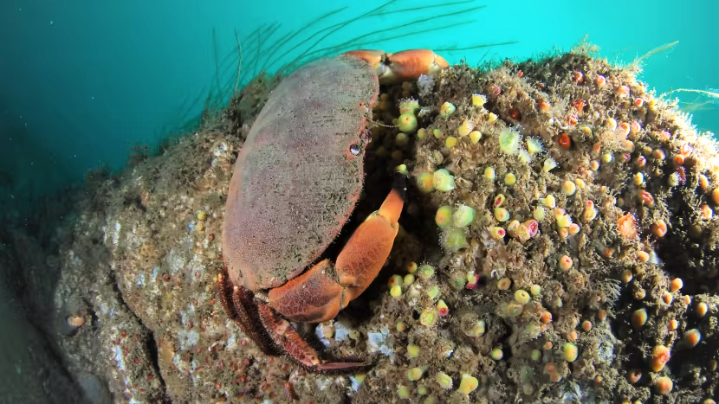

Slide 16
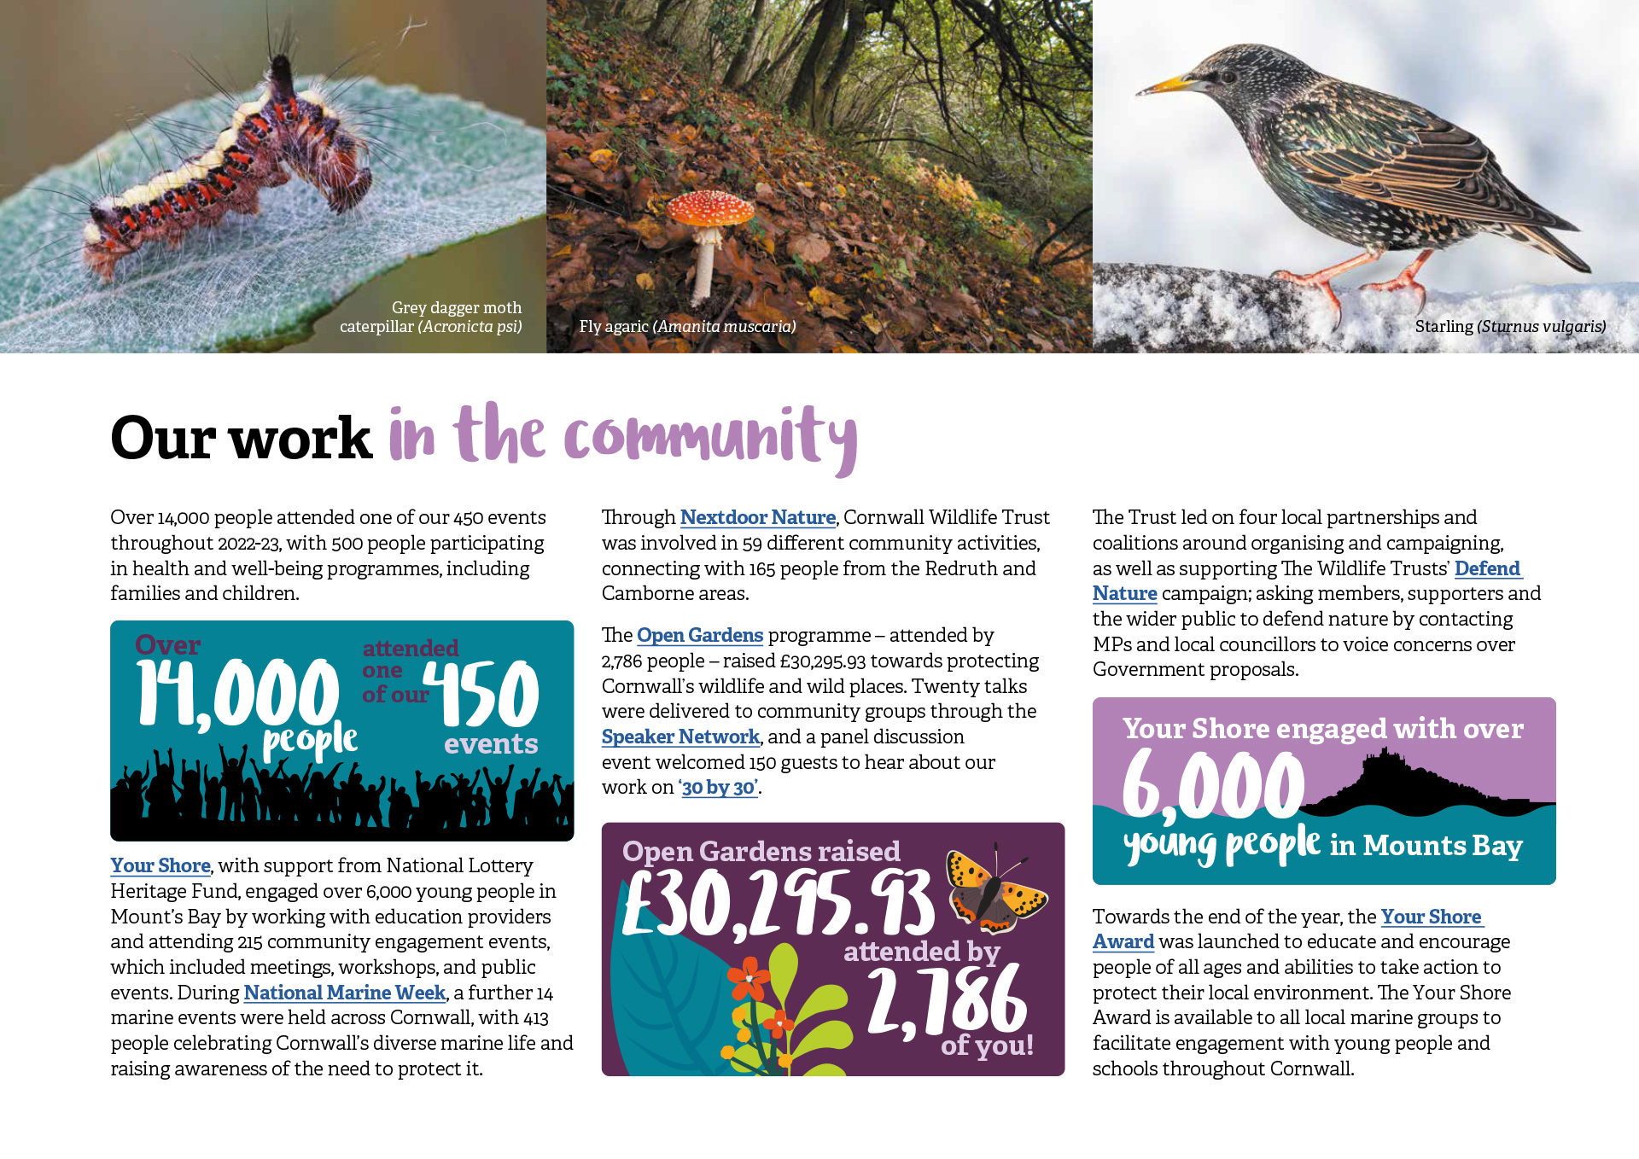

Slide 17
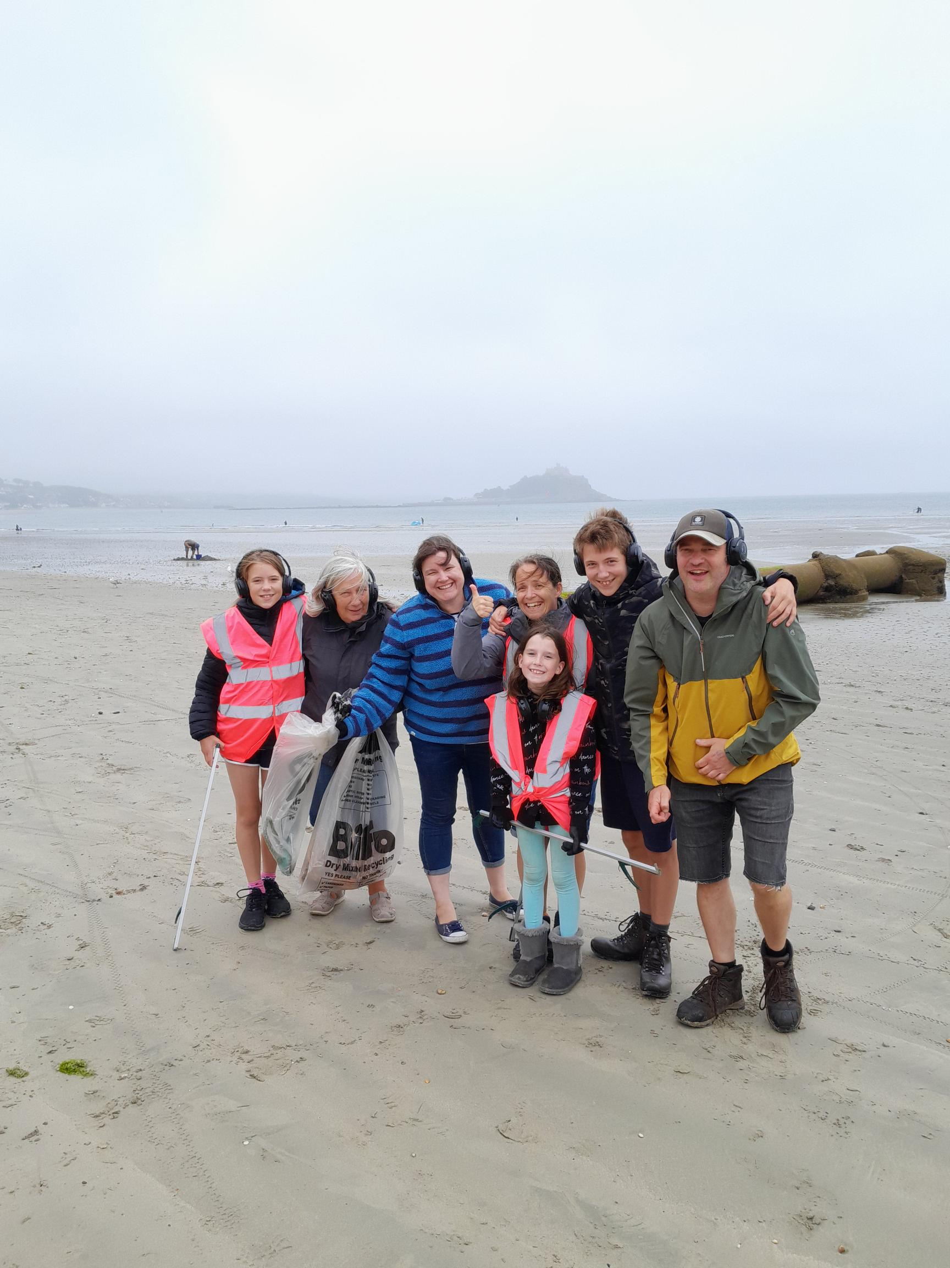
Notes:
2 min beach clear – part of Mounts Bay Marine Trail

Slide 18
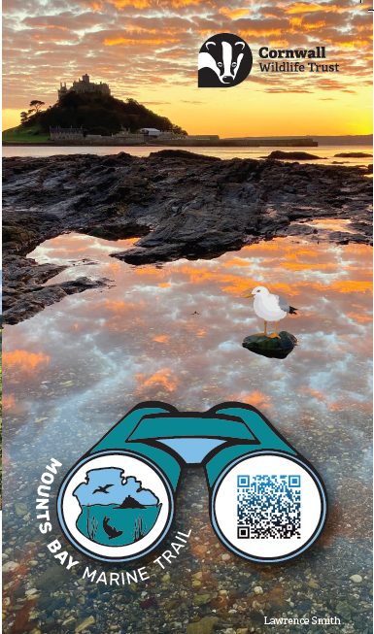
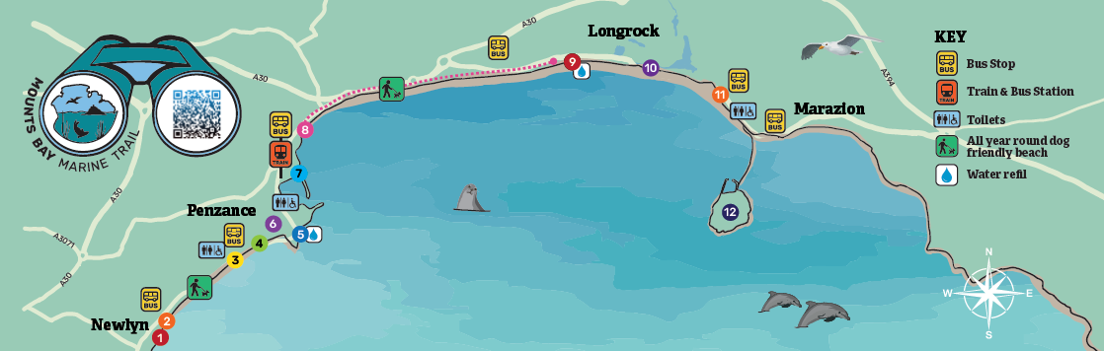
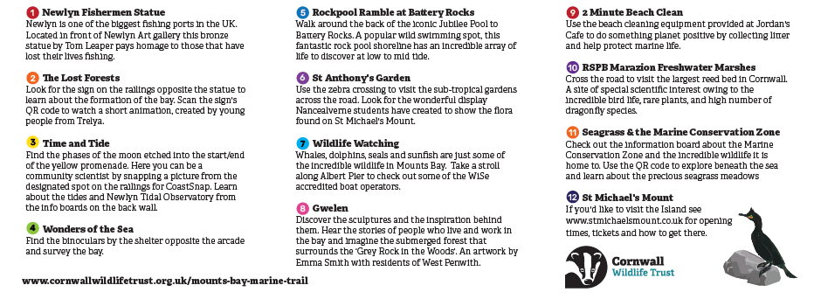
Notes:
Mounts Bay Marine Trail

Slide 19

Help #DefendNature
Send a postcard to your MP today

Slide 20
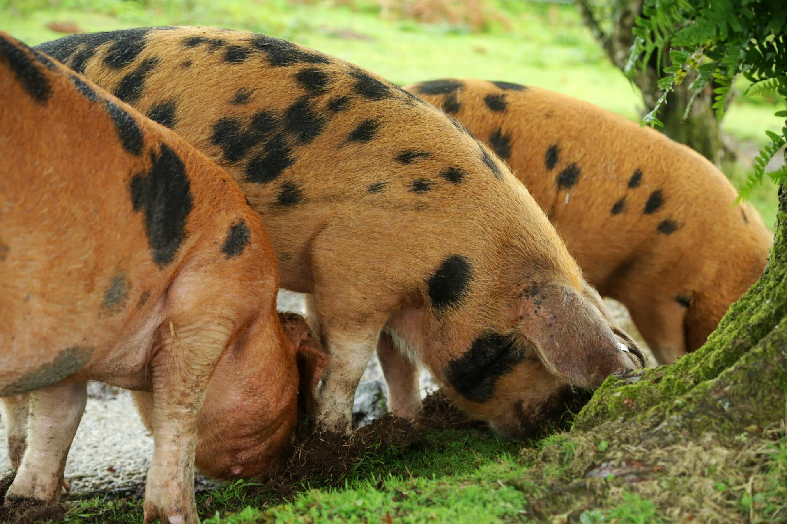
Notes:
Helman Tor pigs

Slide 21
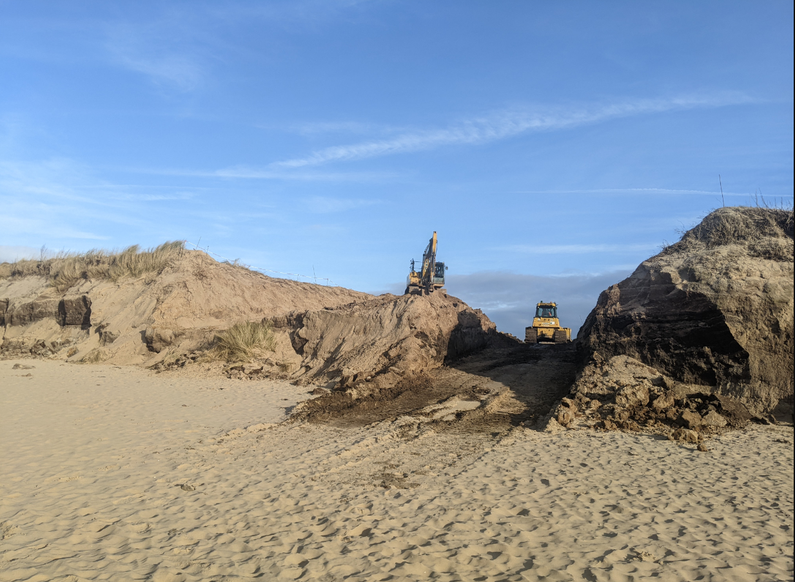
Notes:
Penhale Dune notching

Slide 22
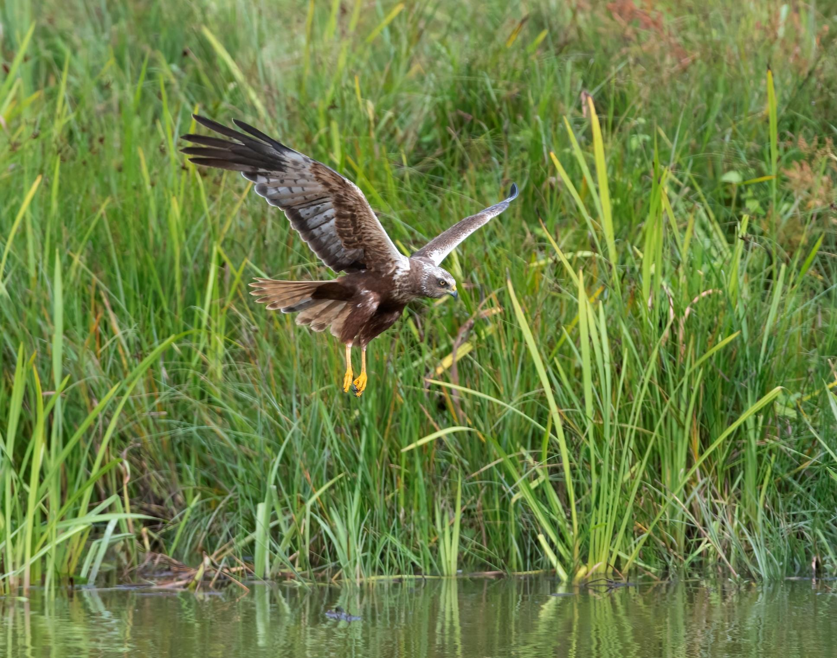
© Adrian Langdon
Notes:
Marsh harriers at Middle Amble marsh

Slide 23
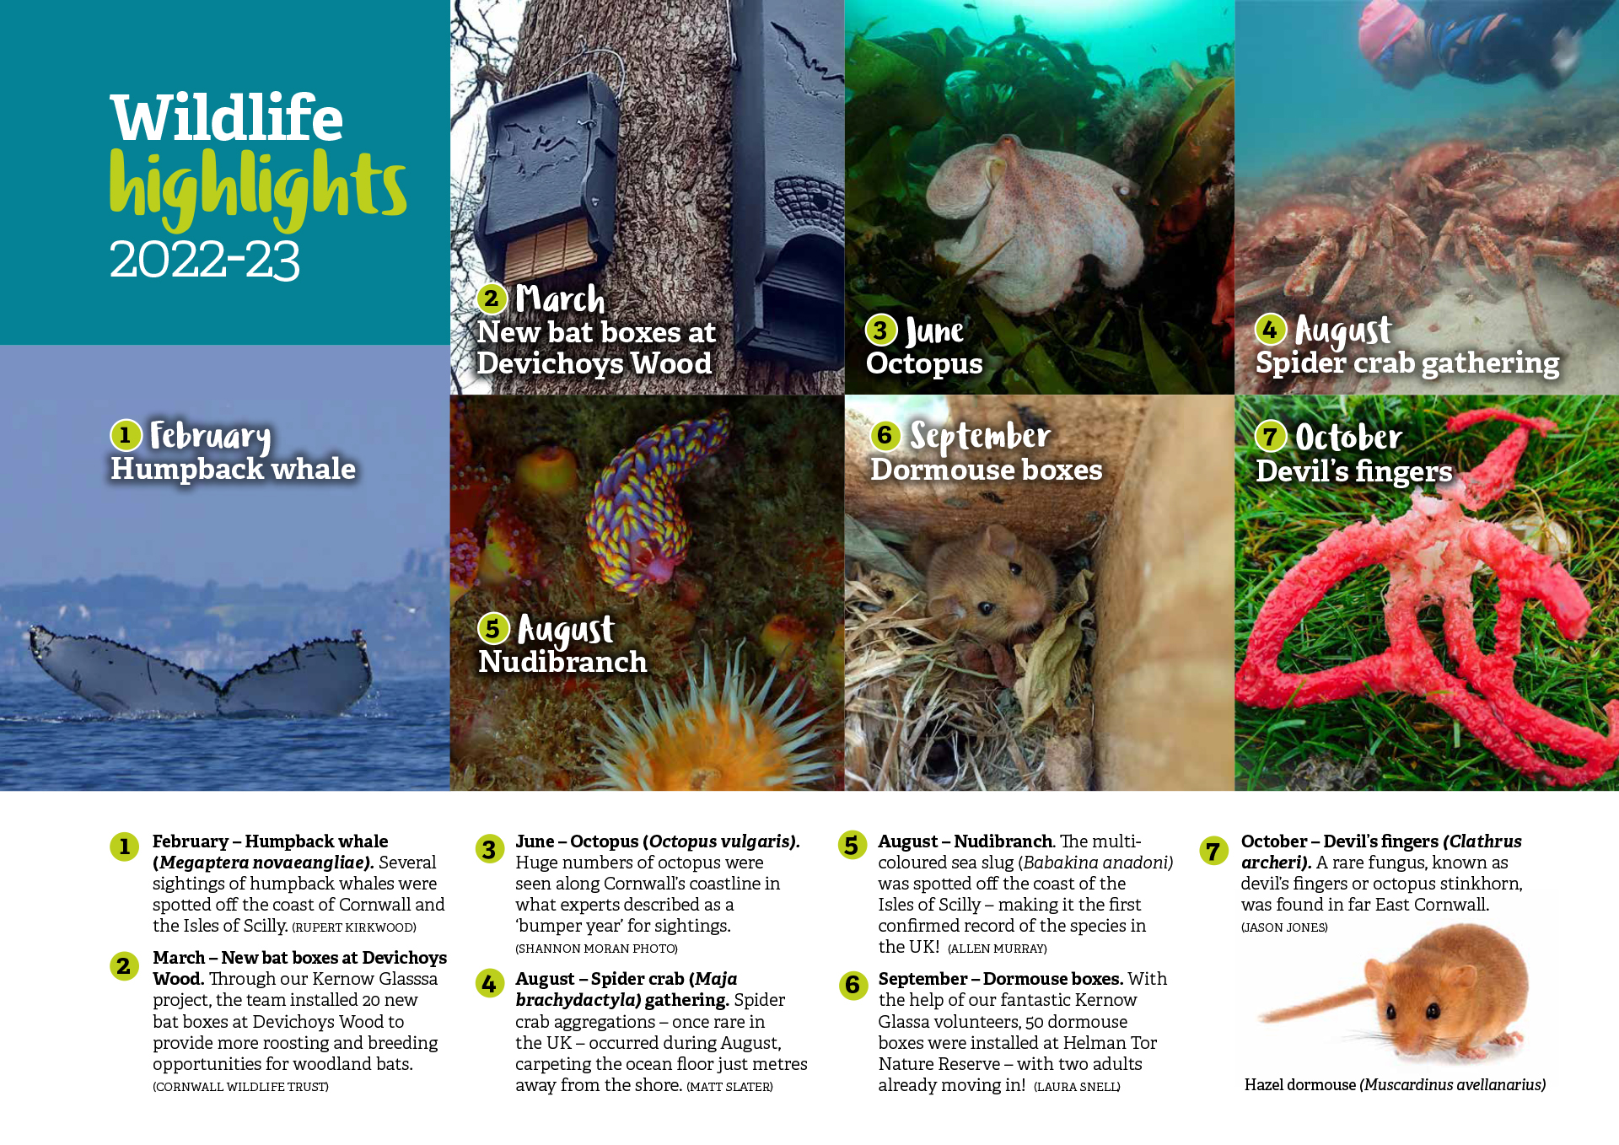

Slide 24
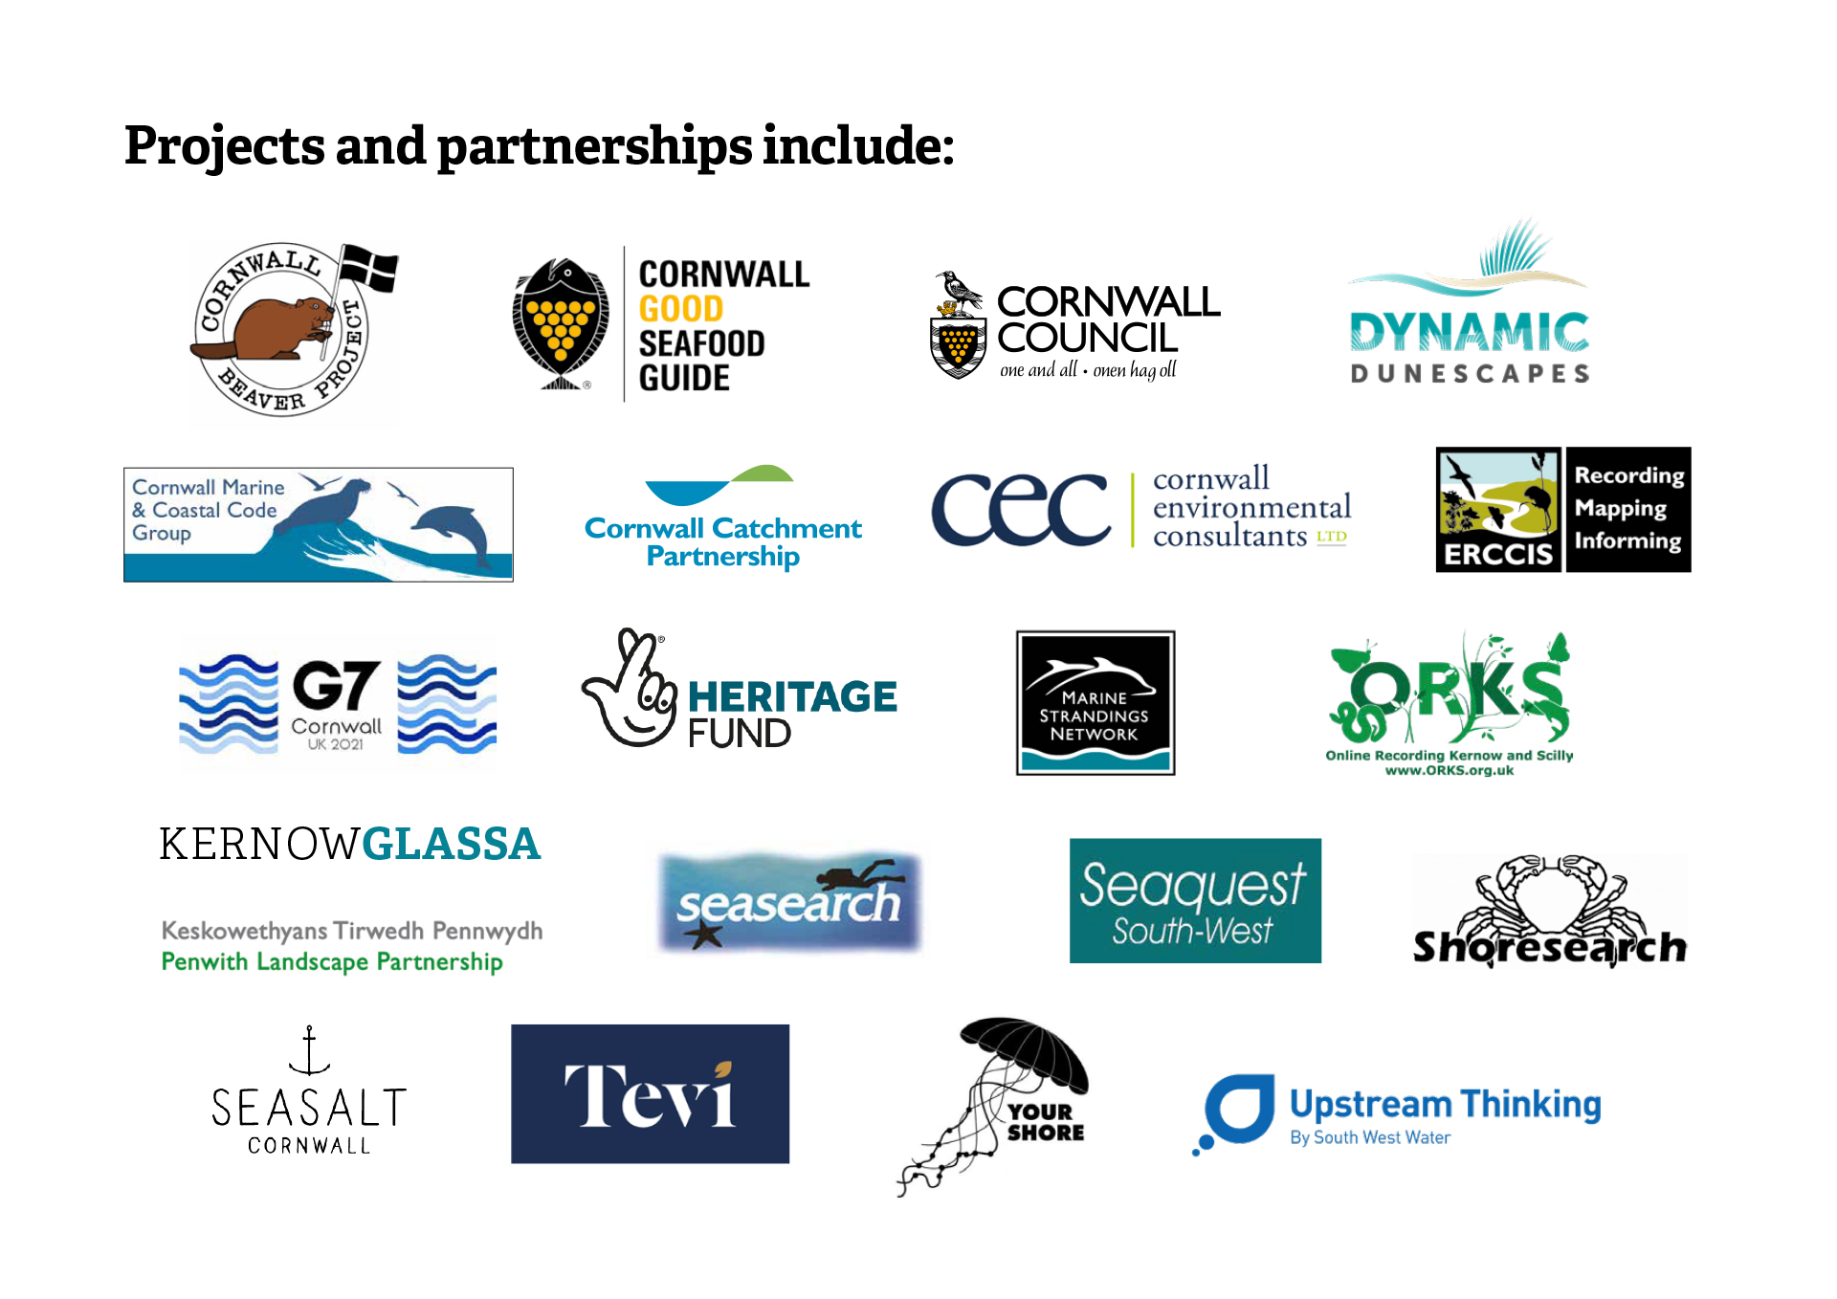

Slide 25
